Slide 1



Education
De-Escalation Techniques: Bring Down the Temperature
BARCLAY PRIMARY SCHOOL TALENT SOLUTION / 2023
Notes:
The key to any successful educators’ day is positive relationships between students, colleagues and parents. A positive relationship can do a lot of the heavy lifting. It is arguable even more important than your style of teaching or the classroom environment. The way you make students feel is what they’ll remember. Here are some quick tips to support you in creating the best possible professional relationships.

Slide 2

Understanding De-Escalation
De-escalation techniques are strategies used to reduce the intensity of a conflict or potentially violent situation. These techniques are essential for maintaining a safe and conducive learning environment.
Notes:
The first step you can take to being a good place to develop positive relationships is to understand what the school is all about. You can do this by having a look on the website, getting to know their policies and procedures. Try to pick up on any recent successes they have had or special activities that they do. This will help you start conversations with colleagues and students. It’ll also give parents confidence that you understand the routines of the school should you need to speak with them.

Slide 3
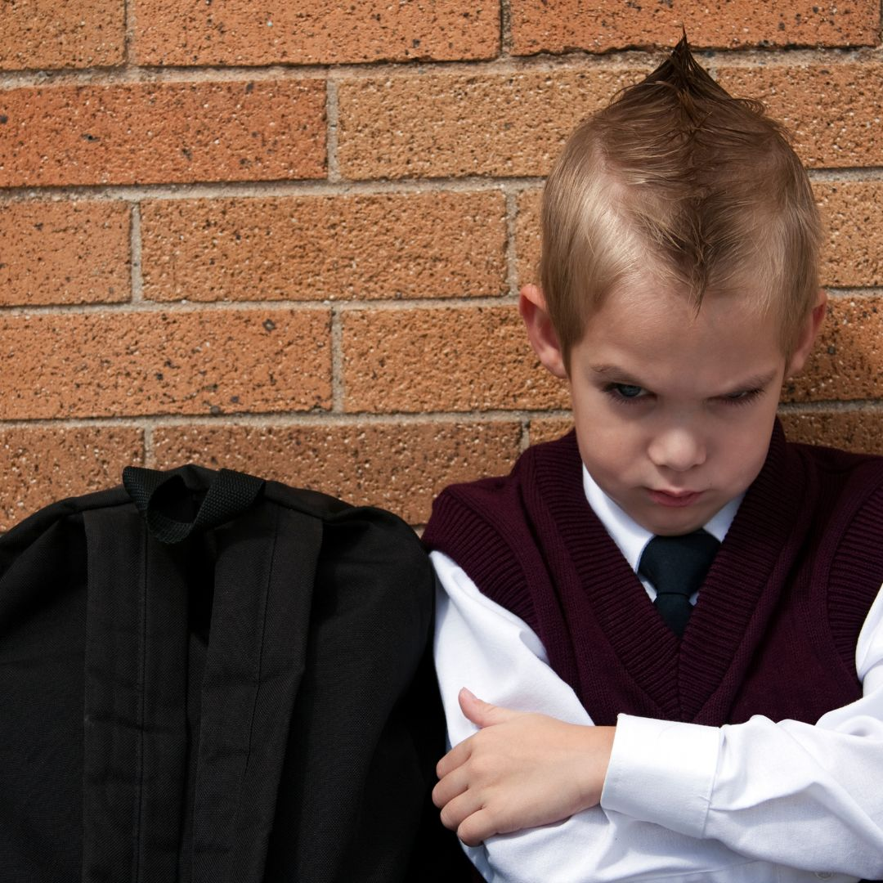
Why De-Escalation Matters
Effective de-escalation helps prevent conflicts from escalating, ensures the safety of all students and staff, and promotes a positive learning atmosphere.
Example: Transaction Analysis – See your role as the adult in most situations, parent if there’s an urgent situation and child at times when you build rapport.
Notes:
You can always start a positive relationship by leading through example. Be on time, dress in an appropriate way and in line with the dress code. Make sure you have all the equipment you need for the day. Information from the school will usually be communicated via the Opogo app. If you have read up on policies and procedures you’ll have an idea of routine but also don’t be afraid to ask colleagues questions. It shows that you care and are looking to do the best possible job. These are simple steps but they’ll really help you make a good first impression to everyone you come into contact with.

Slide 4
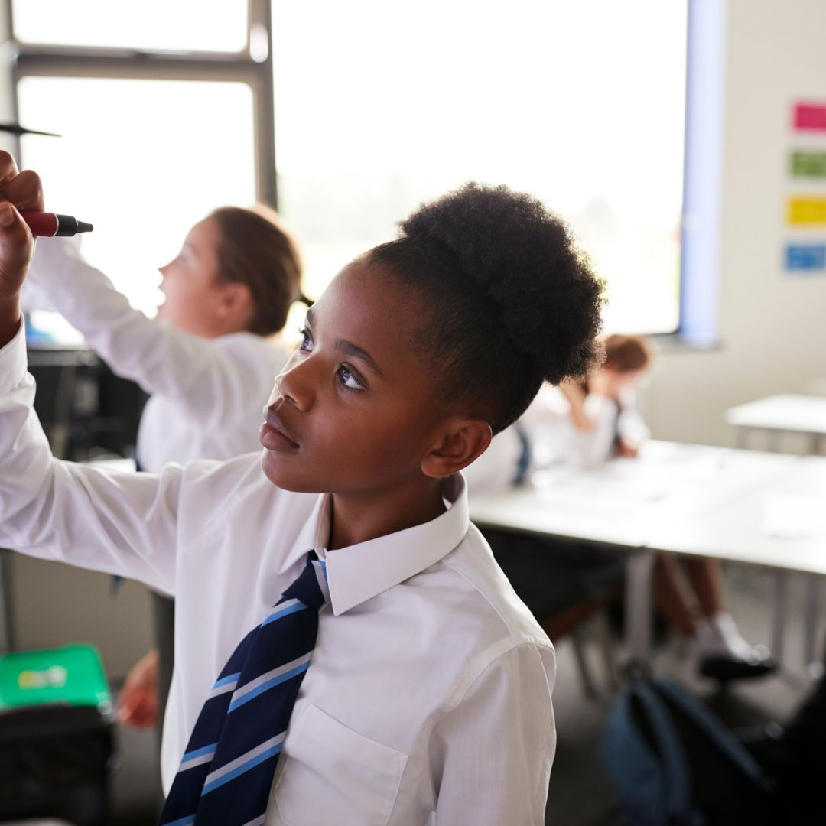
Identify Early Warning Signs
Look out for signs such as raised voices, aggressive body language, and refusal to follow instructions. Early recognition allows for timely intervention.
Example: If a student starts clenching their fists and raising their voice, it’s a sign they might be getting upset. Addressing the issue early can prevent escalation.
Notes:
If it’s your first day, don’t undervalue the role of the school administrators, the staff around the school who support the teaching and the educators themselves. You may need a janitor to help in your classroom or possibly someone in the kitchen to help you! Make sure you are smiling and making good connections everywhere you go. Speak to members of the faculty about the topics you’ll be teaching, ask what the students prior knowledge might be and for any further information about the class you’ll be teaching. If you are given a school email, check it regularly and respond in a polite and courteous way. Of course, learning names and saying good morning are so powerful. Try to learn one thing about all of your colleagues that you can ask them about when you speak with them. This approach also works with students really well!

Slide 5
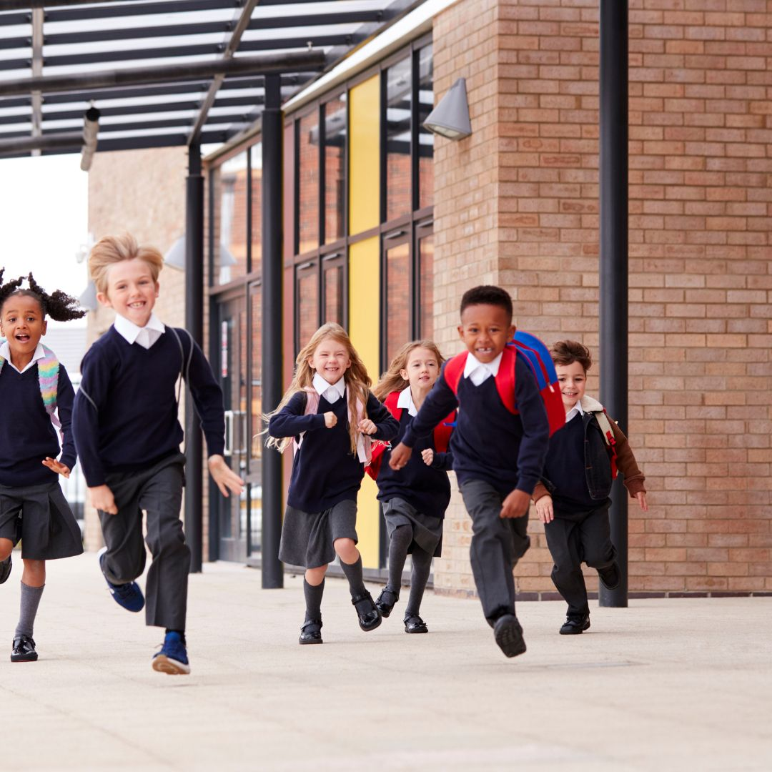
Stay Calm
Teachers should remain calm and composed. A calm presence can help de-escalate the situation and prevent further agitation.
Example: If a student is shouting, respond in a calm, steady voice, “I understand you’re upset. Let’s talk about what’s bothering you.”
Remember why you are there
Notes:
Be kind and respectful at all times. Remember, you may come across someone who is tired, grumpy and a bit short with you. Be patient and remember that we never know what has happened in someone else’s day so you can always just smile and be positive. This applies to everyone you meet. Treat everyone equally well and remember that people will gravitate toward someone who they feel will make them feel that bit better. When speaking with the principal or school administrators, it can be considered polite to ask them how they like to be addressed. Some will have no issue with being called by their first name, however others may wish to have a title such as Mr/Mrs, Principal or another title. Whatever they request, be polite and abide by this. Only act in a way that is respectful and courteous, tension or conflict at work is exhausting and never usually leads to a positive resolution.

Slide 6

Using Non-Threatening Body Language
Adopt an open and non-threatening posture. Avoid crossing arms, pointing fingers, or making sudden movements that could be perceived as aggressive.
Example: Stand with your hands at your sides and maintain a relaxed posture. Avoid looming over the student.
Notes:
You always have an idea of how you’re day will but nothing ever goes perfectly to plan. So be ready for this and go with the flow a little! If you’re asked to change your plans then build that positive relationship by offering to give it your best shot. Try to be as flexible as possible. Remember, you may need someone’s support at another time so you’re putting credit in the bank by offering to be supportive in whatever way possible. If you see a colleague that might need a helping hand, offer to give them it! They’ll tell others about their experiences with you. The same goes for students. Don’t expect your lessons to go perfectly to plan. There will always be things that happen that you don’t expect. Go easy on yourself, be as well prepared as possible and learn from every experience.

Slide 7
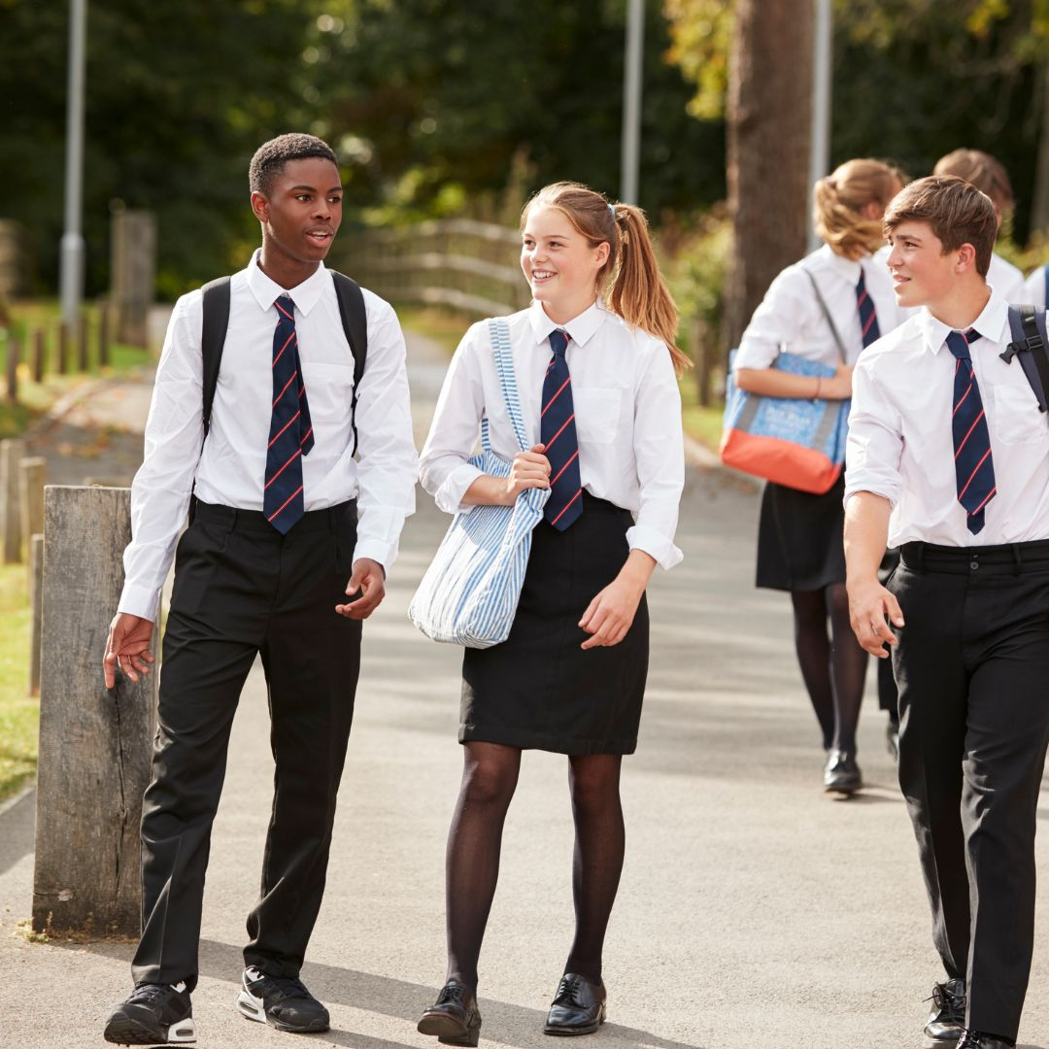
Active Listening Techniques
Show that you are listening by nodding, maintaining eye contact, and repeating back what the student says. This helps the student feel heard and understood.
Example: “I hear you’re frustrated because you feel the assignment is too difficult. Let’s see how we can make it more manageable.”
Notes:
Ask people who may you teach what they feel you could improve upon. A good way to start is by saying, ‘I wonder if you could help me…’ it’s very difficult to say no to that! It will improve what you do and also make them feel like you value their support. You can do the same with students, perhaps ask a couple of students during the lesson if they are understanding what you are teaching and at the end ask what thye’d like to know more about next time. Keep asking, keep listening and keep learning.

Slide 8
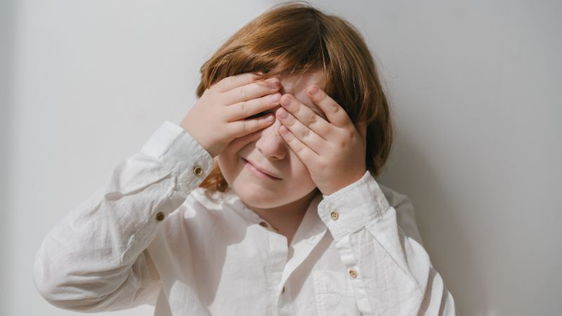
Verbal De-Escalation Strategies
Use a calm and steady tone of voice. Avoid shouting or using confrontational language. Offer choices to give the student a sense of control.
Example: “Would you like to take a five-minute break or talk about what’s upsetting you now?”
Notes:
We’ve said this throughout but a school is a team. Be a team player. Two ears for listening and one mouth for talking! Listen more than you talk to colleagues. Offer to help, don’t speak negatively about others and only raise concerns when you feel that they are negatively impacting on other colleagues or students. Be kind at all times.

Slide 9
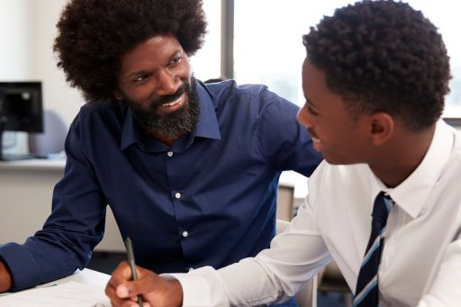
Setting Clear Boundaries and Expectations
Clearly state the behaviour that is expected and the consequences of not adhering to these expectations. Consistency is key.
Example: “It’s important to speak respectfully. If you continue to shout, we’ll need to take a break from this discussion.”
“I’m not speaking to you like that, so please don’t speak to me like that”
Notes:
By taking this course now, you’ve made a big step in your journey toward self-improvement. Always look to better yourself in whatever way you can. There will opportunities to get involved in extra-curricular programmes, if you can, take these chances. You will get to know the students better and show a willingness to be a part of the wider school team.

Slide 10
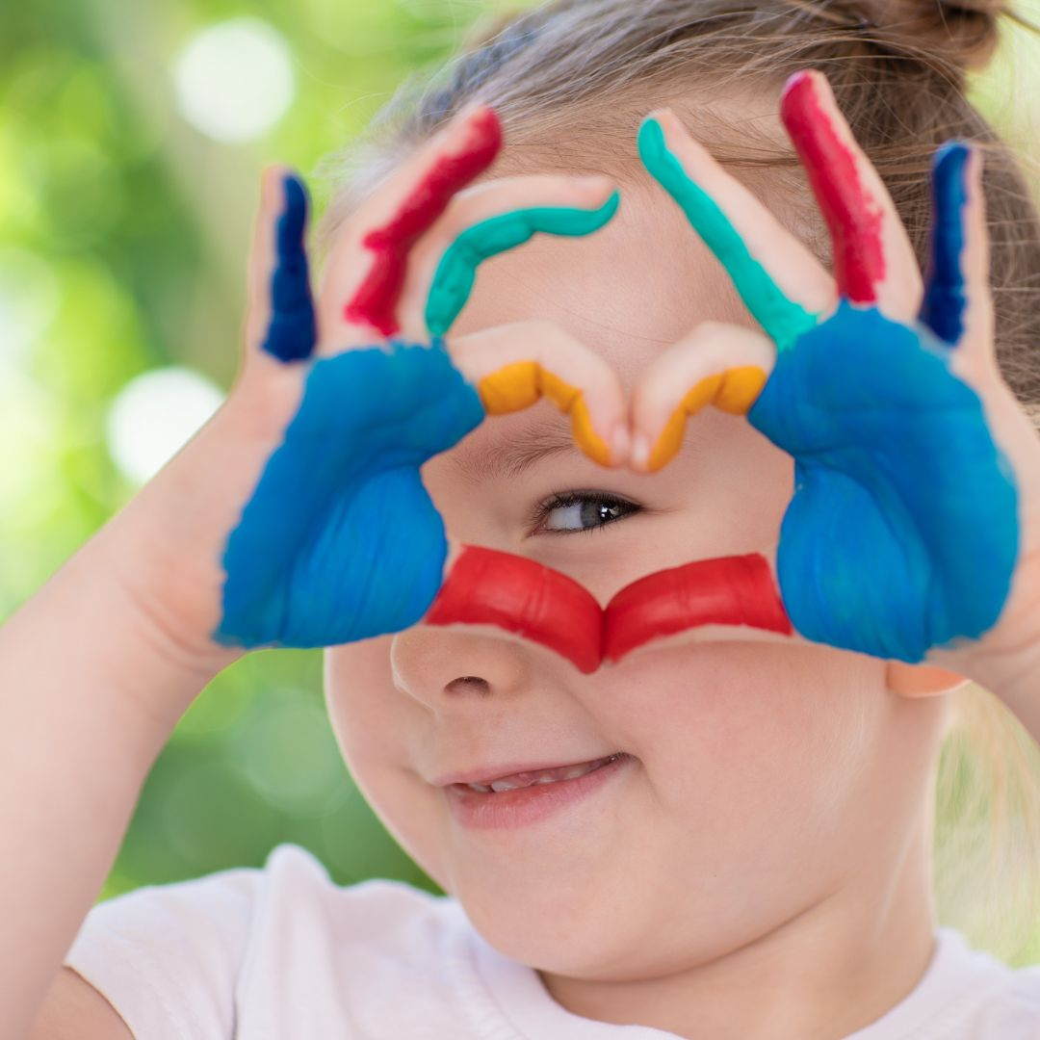
Giving Space
Sometimes, giving the student physical space and time to cool down can help de-escalate the situation. Ensure the student knows they can take a moment to themselves if needed.
Example: “I can see you’re upset. Why don’t you step outside for a few minutes to gather your thoughts?”
Notes:
If you take all of these steps, you will be building a rapport with you students. A rapport, a relationship will make your day so much more enjoyable and really support the students’ learning.

Slide 11

Education
Reflecting and Learning from Conflict
After the incident, reflect on what happened and how it was handled. Discuss with colleagues and consider what could be improved for future situations.
After a conflict, discuss with a colleague, “What could I have done differently to prevent the situation from escalating?”

